Slide 1

Gideons War
Nathan Reeve

Slide 2
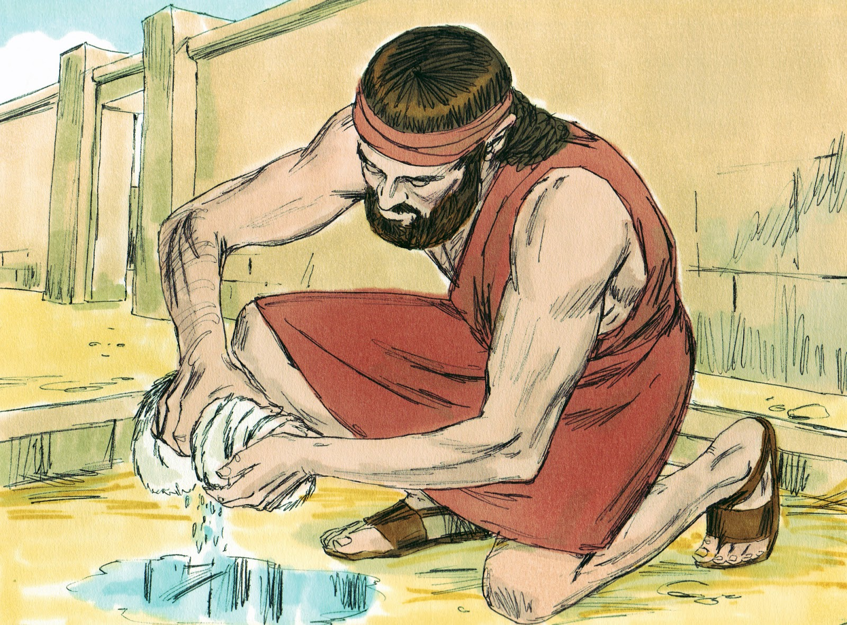
Gideon is Called
Gideon is called to deliver Israel
He does not wish to be a leader
He Overthrows the altar of Baal
He ask for three signs on fleece

Slide 3
Gideon Goes to War
Begins war by destroying the alter of Baal
Gideon challenges a army of Midianites
The Lord challenges the Israelite army to Three challenges
Those who were fearful could leave
Those who drank water from a pond like a dog would be dismissed
Those who took victuals ad instruments in their hands could stay

Slide 4
The Divisions of the Army
Those who were fearful may leave
22,00 – 10,000
01
Those who drink water like a dog
10,000 – 300
02
The 300 took instruments and victuals to war
03

Slide 5
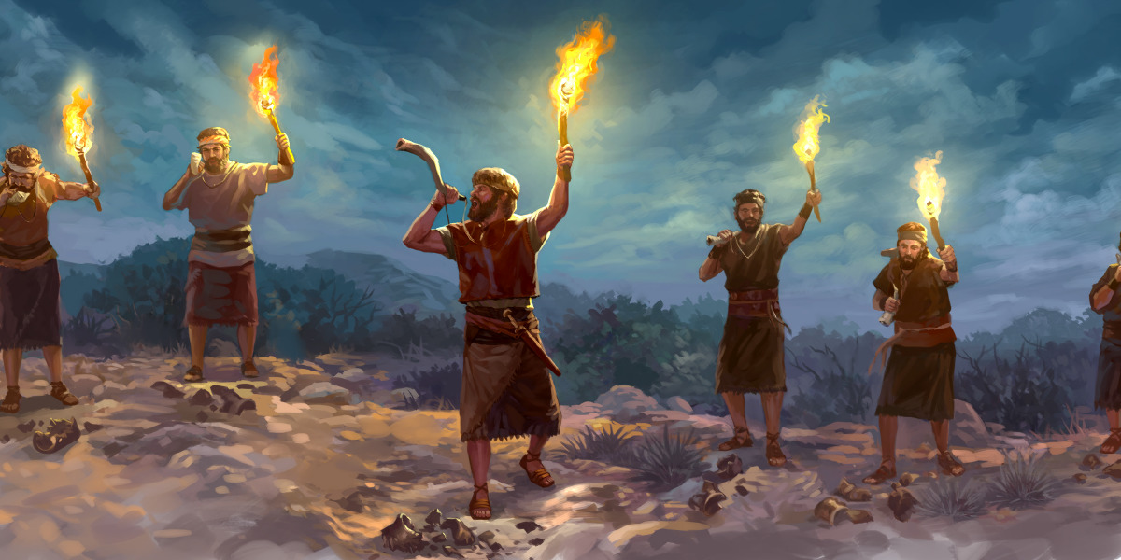
Gideon is the victor
Gideon and the men of Ephraim pursue and defeat the Midianites
Gideon rejects the request of the people to become king
Gideon creates a idol for the people to worship
Gideon lived to be a elder and passed away peacefully

